Slide 1
Transitioning to Canvas
Dan Murphy – Instructional Design Manager
Matthew Jennings - Instructional Design Specialist, Sr.
James Henson – Instructional Design Specialist
J. Clark – Instructional Design Specialist

Slide 2
Naming Conventions
Letters
Numbers
Underscore
Periods (for file extension)
Dash (if there don’t change)

Slide 3
Folder Structure
00_Home
01_Course_Information
Course Overview
Topical Outline
Etc.
02_Modules
Module_01
Module_02
Etc.
03_Assignments
Rubric
Etc.

Slide 4
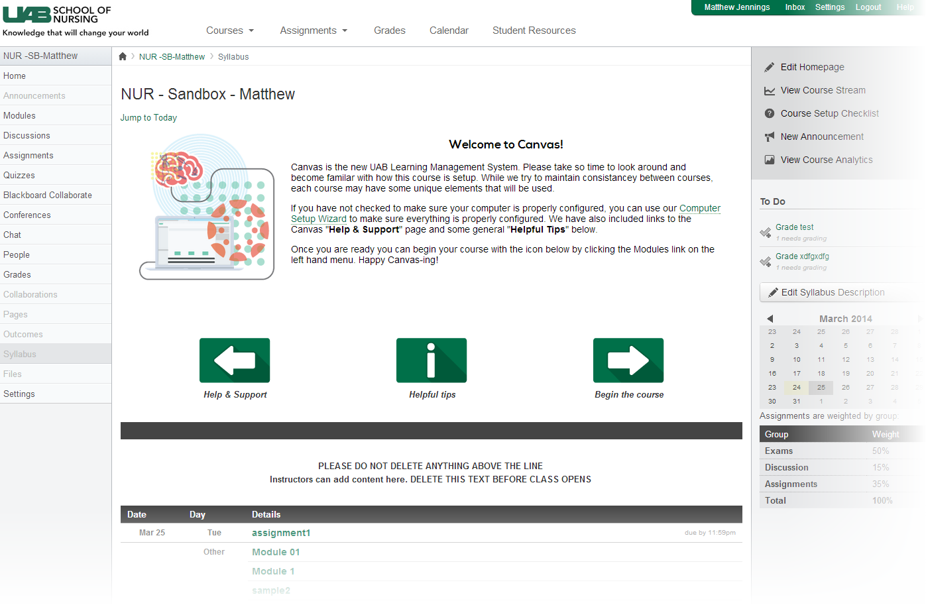
Standardized Home Page

